Slide 1
Sudharsanan .SR 421221104043
Final Project
3/21/2024 Annual Review

Slide 2
PROJECT TITLE
Vehicle Image Generation using Generative Adversarial Networks (GANs)
3/21/2024 Annual Review

Slide 3


AGENDA
Introduction
Problem Statement
Project Overview
End Users
Solution and Value Proposition
The WOW in Your Solution
Modeling
Results
Conclusion
3/21/2024 Annual Review

Slide 4

PROBLEM STATEMENT
Develop a GAN capable of generating new vehicle designs efficiently.
Challenges:
Limited dataset size.
Inconsistent image backgrounds and angles.
Imperfect image quality due to small dataset.
3/21/2024 Annual Review

Slide 5

PROJECT OVERVIEW
Overview:
Goal: Develop a GAN to generate vehicle images.
Components: Generator model, discriminator model, training loop.
Dataset: Comprehensive Cars Dataset.
Methodology:
Data preprocessing.
Model training and evaluation.
3/21/2024 Annual Review

Slide 6

WHO ARE THE END USERS?
End Users:
Automotive designers and engineers.
Potential Use Cases:
Inspire new vehicle designs.
Efficient exploration of design possibilities.
Accelerate prototyping and innovation.
3/21/2024 Annual Review

Slide 7

YOUR SOLUTION AND ITS VALUE PROPOSITION
Solution:
Developed a GAN to generate vehicle images.
Value Proposition:
Efficient exploration of new vehicle designs.
Reduced prototyping costs and time.
Inspiration for designers and engineers.
3/21/2024 Annual Review

Slide 8
THE WOW IN YOUR SOLUTION
WOW Factor : Ability to generate realistic vehicle designs.
Steady improvement in image quality during training.
Recognition of vehicle outlines and features.
3/21/2024 Annual Review
8

Slide 9
Modeling of Vehicle Image Generation using Generative Adversarial Networks (GANs)
GAN Architecture:
Generator model.
Discriminator model.
Training loop.
Dataset:
Comprehensive Cars Dataset.
1324 front-facing vehicle images.
3/21/2024 Annual Review
9

Slide 10
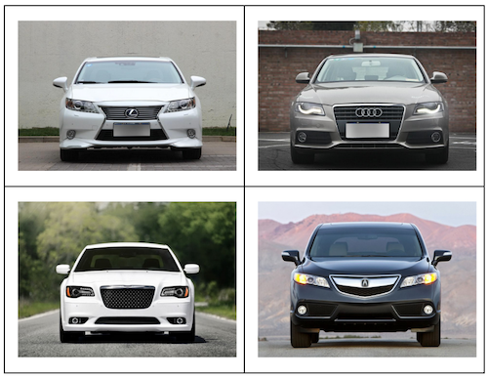
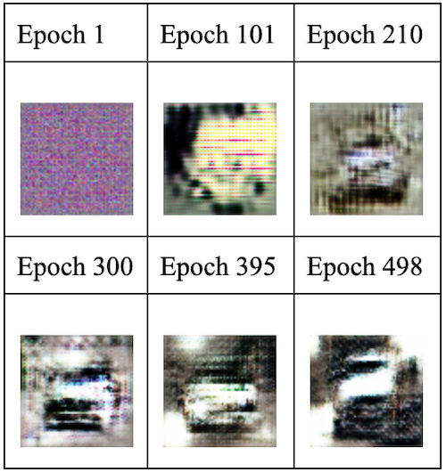
RESULTS
64px image generated
Sample data set
3/21/2024 Annual Review
10

Slide 11
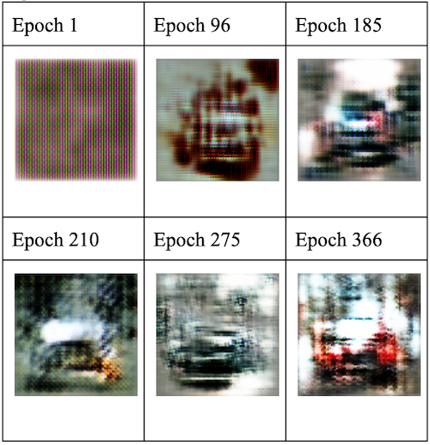
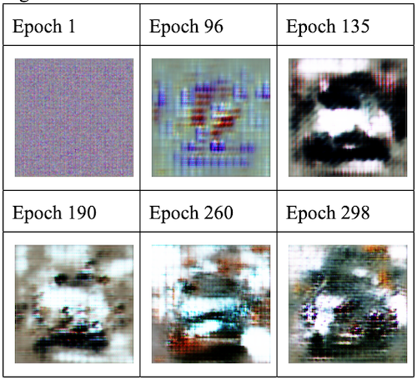
96px generated image
128px generated image
Challenges: Imperfect image quality due to dataset limitations.
Stagnation in model progress after certain epochs.

Slide 12
CONCLUSION
Conclusion:
Developed GAN for vehicle design.
Output recognizable vehicle images.
Limitations: Small dataset, inconsistent image backgrounds.
Future Directions:
Test on larger and more uniform dataset.
Explore higher resolutions and additional features.

